Slide 1

Interleaved Reasoning for Large Language Models via Reinforcement Learning
A novel approach for faster, more accurate, and interactive AI reasoning from Apple and Duke University researchers.
Authors: Roy Xie, David Qiu, Deepak Gopinath, Dong Lin, Yanchao Sun, Chong Wang, Saloni Potdar, Bhuwan Dhingra

Slide 2
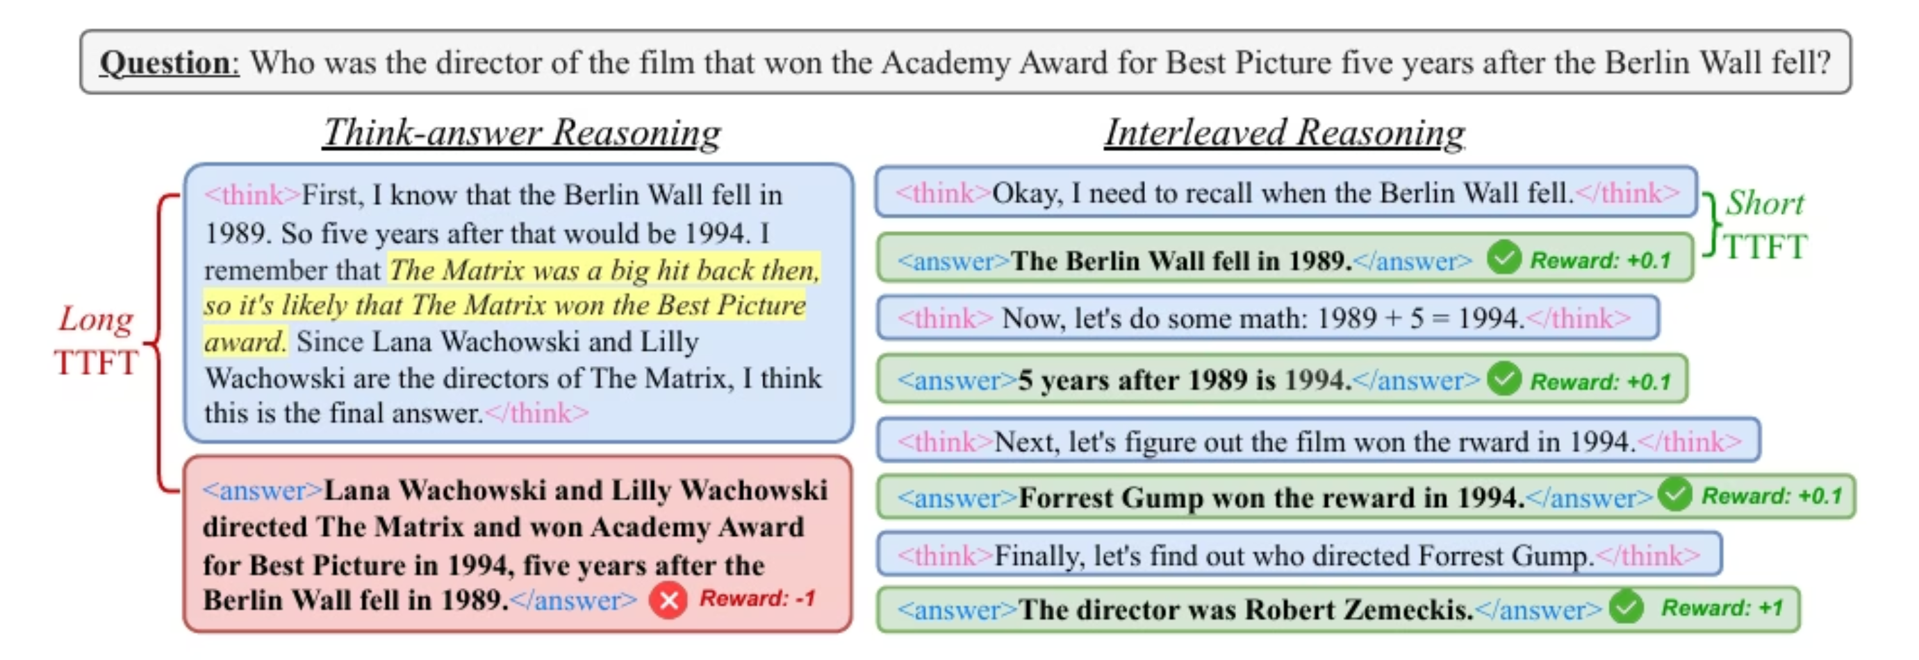
Why Traditional Reasoning Falls Short
Current Challenges
Sequential "think-then-answer" paradigm slows response time
Extended reasoning chains increase error probability
Poor time-to-first-token (TTFT) hurts user experience
Limited opportunity for intermediate feedback

Slide 3




Introducing Interleaved Reasoning
Think
Answer
Model processes problem information
Generates intermediate responses
Iterate
Conclude
Continues thinking and refining answers
Provides final, accurate solution
This approach dramatically reduces TTFT while improving accuracy through better training feedback opportunities.

Slide 4
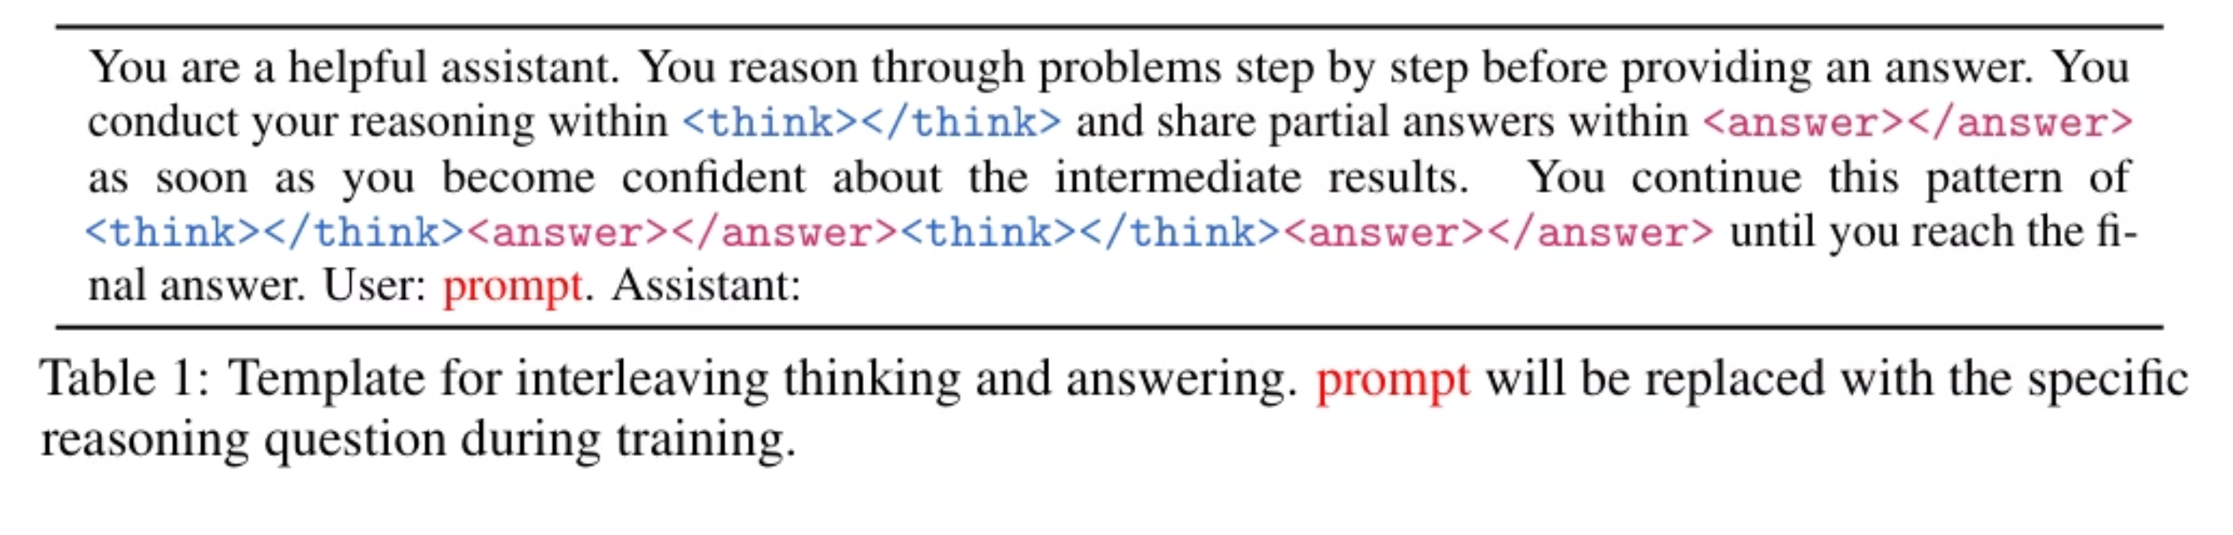
Training LLMs for Interleaved Reasoning
1
Multi-hop Problem Decomposition
2
Thinking vs. Answering Distinction
3
Formal Interleaved Structure
Questions are broken into "sub-answers" - distinct, user-facing pieces of information that represent a completed reasoning stage or milestone.
Thinking: Private internal reasoning process not directly useful to users
For N reasoning steps, policy model πθ produces sequence: y(1)think ◦ y(1)answer ◦ y(2)think ◦ y(2)answer ◦ ... ◦ y(N)answer
Answering: Generation of public, finalized conclusions forming meaningful responses
Each thinking segment guides reasoning for the subsequent answer segment
Each sub-answer functions as a conclusive statement for that stage, allowing responses to be built incrementally.
4
Implementation Template
Special tags <think></think> and <answer></answer> structure the interleaved reasoning process.The complete interleaved template is:

Slide 5



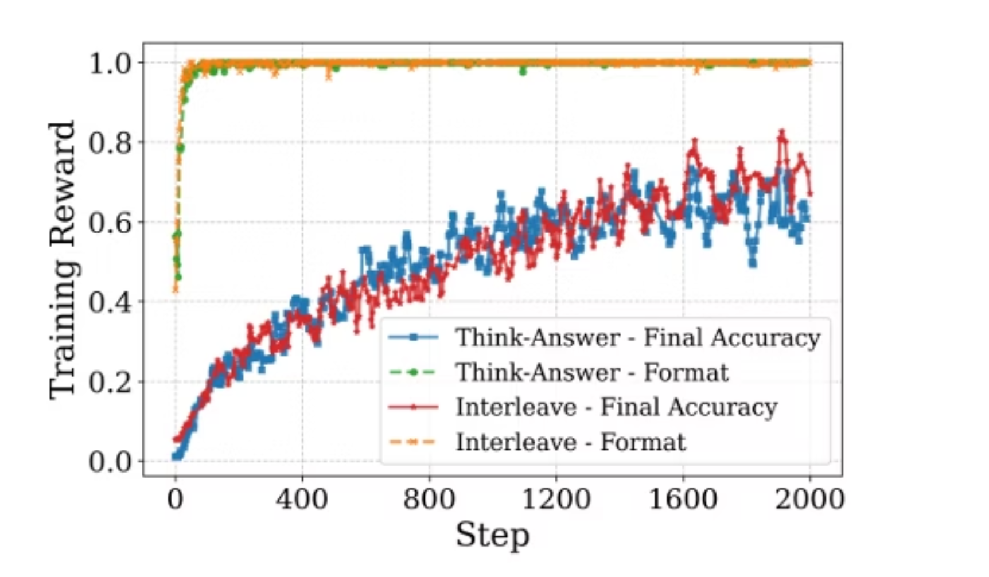
Sophisticated Reward Engineering
Format Reward
Final Accuracy Reward
Intermediate Accuracy Reward
Evaluates correct use of interleaved structure with proper completion of think/answer segments
Measures correctness of final solution after complete reasoning process
Provides signals for correct sub-answers, applied conditionally based on training progress
Models Are Quick Format Learners
Base models inherently possess the ability to interleave thinking and answering, even without RL training—though with reduced accuracy.
Our key insight: The challenge isn't teaching structural adherence but enhancing thought quality for different reasoning tasks.
The format reward rapidly reaches a plateau during training, significantly faster than the accuracy reward, suggesting that LLMs naturally adopt structural patterns

Slide 6

Intermediate Reward Calculation
Format Verification
Ensures model output structure adheres to prescribed reasoning pattern
Final Answer Accuracy
Validates that ultimate solution is correct before rewarding intermediate steps
Conditional rewards ensure the model masters primary objectives before optimizing for generating correct intermediate reasoning steps.
The overall reward function:
Training Progression
Confirms current batch accuracy exceeds previous batch (within threshold ε)

Slide 7
Intermediate Reward Calculation
All-or-None Approach
Partial Credit Approach
Time-Discounted Approach
Requires complete sequential correctness in intermediate reasoning steps before any reward is granted. Creates a high standard for model performance but offers less granular training signal.
Allocates proportional rewards for individual correct intermediate steps, even if the complete sequence contains errors. Provides more balanced training feedback for partially correct reasoning.
Assigns higher reward values to earlier correct reasoning steps, with bonus rewards for completely correct sequences. Incentivizes both speed and accuracy in the reasoning process.
While training utilizes datasets with intermediate ground truths, our models successfully generalize to unseen dataset demonstrating robust transfer learning capabilities.

Slide 8



Conditional Intermediate Reward Strategies
All-or-None
Partial Credit
Time-Discounted
Demands complete sequential correctness before granting reward (Rbase=0.5)
Allocates proportional rewards for individual correct steps, regardless of sequence errors
Prioritizes early correct answers with harmonic weighting (1/kj)
Full Rbase reward when all steps correct; quickly drops with any error
Creates high standard but offers less granular training signal
More forgiving approach allowing recovery from early mistakes
Our evaluation demonstrates that Time-Discounted strategy performs best overall, effectively balancing early correct answers with maintaining coherent reasoning throughout the process.

Slide 9

Experimental Models and Baselines
Core Model Architecture
All experiments conducted using Qwen2.5 instruct models with parameter sizes of 1.5B and 7B to evaluate performance across different model scales.
Comprehensive Baseline Comparisons
Direct Inference: Single-step answer generation without explicit reasoning
Chain-of-Thought (CoT): Complete reasoning before final answer
Our Approaches
Supervised Fine-Tuning (SFT): Traditional instruction tuning approach
Interleave: Base approach without intermediate rewards
Think-Answer: Standard RL methods.
Interleave + IR: Main approach with time-discounted conditional intermediate rewards
All evaluation setups maintain consistent parameters across baseline and interleaved approaches, ensuring fair comparison of reasoning methodologies.

Slide 10






Policy Optimization: Training Our Interleaved Reasoning Model
Group Relative Policy Optimization (GRPO)
Eliminates need for critic network
More resource-efficient during training
Proximal Policy Optimization (PPO)
Advantage: Sample efficient approach
Uses a separate critic network to approximate state value function
Limitation: More sensitive to hyperparameter choices
Leverages Generalized Advantage Estimation
Advantage: More stable training process
REINFORCE++
Limitation: Requires additional warm-up steps
Alternative approach without critic network
Reduces computational resources required
Advantage: Sample efficient implementation
Limitation: Requires careful hyperparameter tuning
Our experiments evaluate these three approaches for optimizing Qwen2.5 models in the interleaved reasoning framework, balancing training stability against computational efficiency.

Slide 11

Training Details: Hardware and Configuration
Implementation Specifications
Our primary training leverages Proximal Policy Optimization (PPO) for its superior stability across all experimental conditions.
Training conducted on 8× NVIDIA H100 GPUs (80GB memory each)
Models trained up to 2,000 steps with checkpoint selection based on highest test scores
Time-Discounted method utilized for intermediate reward calculation
High-performance computing infrastructure powers our interleaved reasoning experiments
We maintain strict experimental parity between think-answer and interleaved approaches, ensuring fair methodology comparisons.

Slide 12
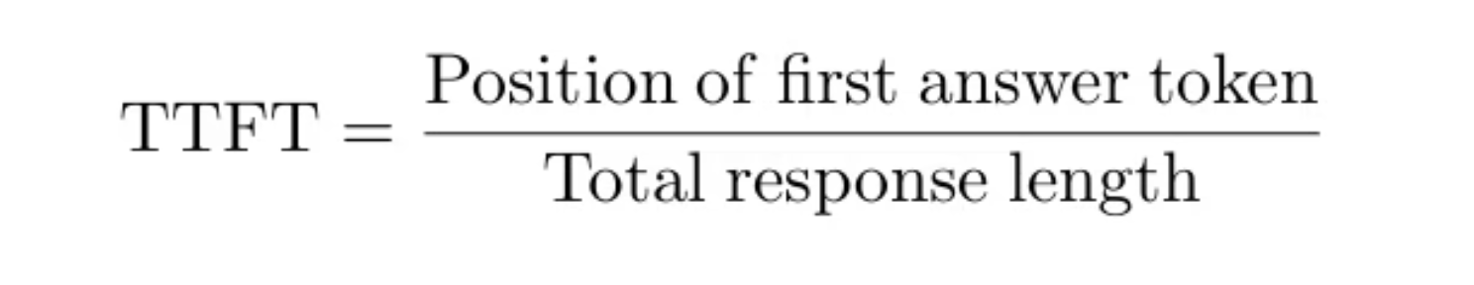
Evaluation Metrics: Measuring Success
1
Pass@1 Accuracy
2
Time-to-First-Token (TTFT)
Measures solution correctness using Exact Match (EM) methodology
Quantifies response speed to measure user experience improvements
Calculates percentage of correct final answers against ground truth
Adapted metric: relative position of first answer token in complete response
Normalized comparison between model's answer and reference solution
Allows fair comparison across different reasoning approaches
A prediction is considered correct only if it exactly matches the normalized ground truth.
These complementary metrics provide a comprehensive view of model performance—balancing solution quality with response efficiency—essential for real-world applications where both correctness and speed matter.

Slide 13

Remarkable Performance Improvements
Speed Without Sacrificing Accuracy
Intermediate Rewards Boost Effectiveness
Base interleaved approach maintains comparable Pass@1 accuracy to traditional think-answer baseline while reducing Time To First Token (TTFT) by over 80% across models
Interleave+IR implementation yields remarkable relative improvements: 19.3% (1.5B model) and 5.7% (7B model) in accuracy with maintained TTFT reductions
Strong Out-of-Domain Generalization
Users receive informative responses nearly 5× faster with interleaved reasoning
Model demonstrates superior performance across GPQA, MMLU, and MATH datasets without requiring specific training data from those domains
Our experiments confirm that incremental feedback is crucial - delayed intermediate answers perform significantly worse than true interleaved reasoning, validating our approach for practical applications.

Slide 14
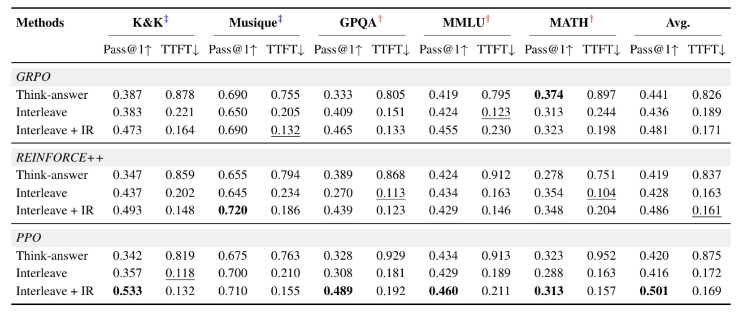
In-Depth Analysis: Impact of Design Choices
Timing of Intermediate Answers
1
Standard Interleave
Provides immediate incremental feedback throughout reasoning process
Maintains high Pass@1 accuracy and low TTFT
2
Delayed Intermediate
RL Algorithm Comparison
Generates intermediate answers only after full reasoning trace
PPO gives the best results overall but needs more training time to get there.
GRPO and REINFORCE++ learn faster with fewer examples, but their training is less stable.
Substantially lowers accuracy and increases TTFT
Interleave + IR works better than Think-Answer every time, no matter which training method is used.
Diminishes benefits of Intermediate Rewards

Slide 15
Evaluation Datasets
Comprehensive Evaluation Datasets
In-Domain Testing
Out-of-Domain Generalization
Knights and Knaves (K&K): Multi-step logical reasoning with varying difficulty levels
GPQA: General physics questions requiring complex reasoning
Musique: Multi-hop question answering requiring information synthesis from multiple sources
MMLU: Massive multitask evaluation across diverse domains
MATH: Advanced mathematical problem solving
Both datasets contain natural subproblems with ground truth, making them ideal for training our interleaved reasoning approach. Future work will explore datasets without intermediate ground truth.

Slide 16
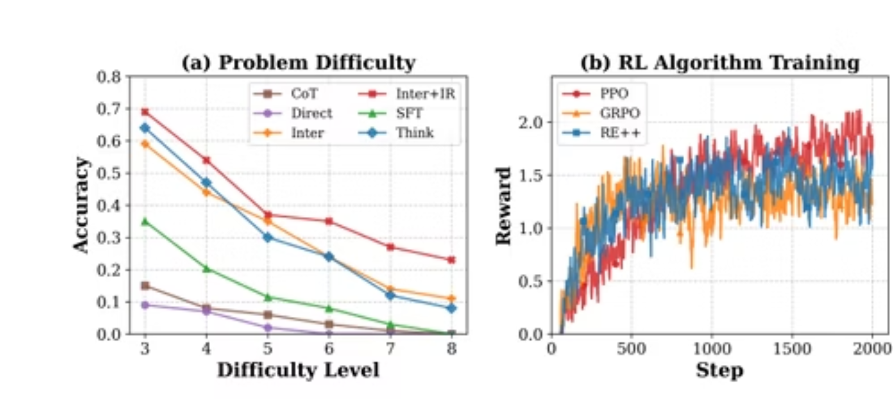
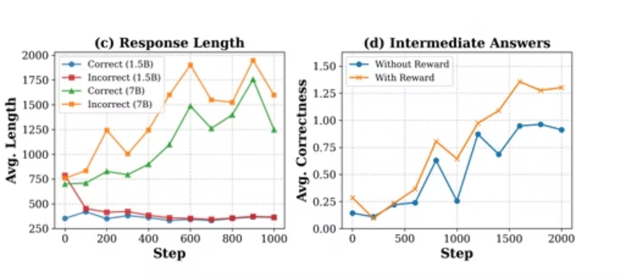
Analysis and Discussions
Performance gap widens on harder K&K problems as difficulty increases;
Response length analysis revealing correct answers are typically shorter
Training dynamics across different RL algorithms showing convergence patterns
Effect of intermediate rewards on model behavior showing increased correct intermediate answers

Slide 17
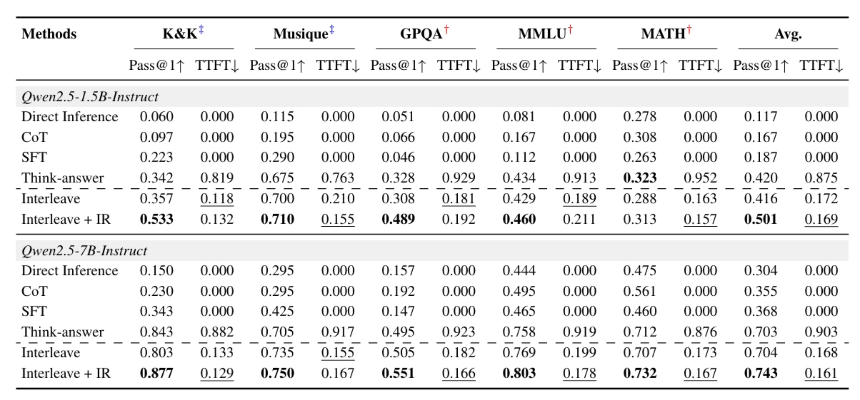
Remarkable Performance Improvements
+19.3%
-80%
Accuracy Gain
TTFT Reduction
Significant Pass@1 accuracy improvement for 1.5B parameter models
Dramatic decrease in time-to-first-token, enhancing user experience
Consistently outperforms Chain-of-Thought and conventional Think-Answer approaches across benchmarks.

Slide 18
In-Depth Analysis
Complexity Advantage
Performance improvements are more pronounced on difficult problems, suggesting this approach scales well to challenging scenarios
Feedback Timing
Incremental feedback consistently outperforms delayed feedback, highlighting the value of interactive reasoning processes
Algorithm Comparison
PPO demonstrates superior stability across experiments, while time-discounted rewards yield the best overall performance

Slide 19

Conclusion and Future Directions
Key Takeaways
Interleaved Reasoning dramatically improves both speed and accuracy
Simple yet effective training methodology without external tools
Conditional rewards create more stable training dynamics
Generalizes well beyond training domains
Next Steps
Exploring applications in conversational AI, multi-modal reasoning, and human-in-the-loop systems

